Slide 1


Learning VimScript
@PrabirShrestha – Sep 2020

Slide 2
OSS VIM Projects
vim-lsp
asyncomplete.vim
quickpick.vim
async.vim
callbag.vim
typescript-language-server

Slide 3
Vimscript v9
This talk will not cover vimscript version 9.
Vimscript/Viml in this presentation will refer to version <= 8.

Slide 4
Hello World Vimscript
:echo "Hello world"
:let message = "Hello world"
:echo message
Notes:
:echo "Hello world“

Slide 5
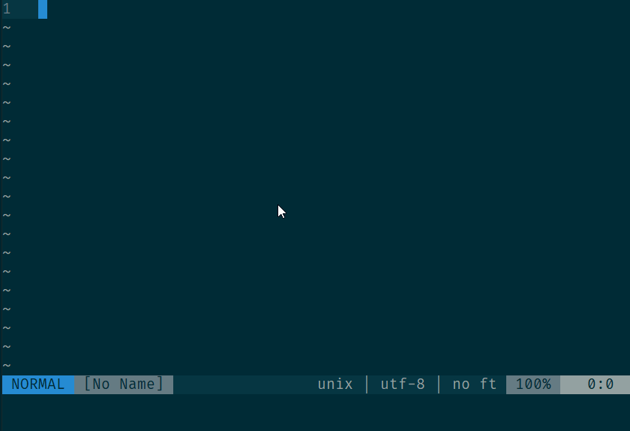
.vimrc
echo "Hello"
echo "World"
echom "Hello"
echom "World"

Slide 6
What is Viml/Vimscript <= 8?
Interpreted
Imperative
Dynamic
Partial Runtime Type Checks
Functional
Optional Simple Object Oriented

Slide 7
:help
:help is your best friend

Slide 8
Variables

Slide 9
:help variables
string
number
float
null
dictionary
list
funcref
Job
Channel
Blob

Slide 10
:help variables
let string = "String"
let number = 1
let float = 1.0
let list = [1, 2, "hello", "world" ]
let dictionary = { "message": "hello world" }
Notes:
let string = "String"
let number = 1
let float = 1.0
let list = [1, 2, "hello", "world" ]
let dictionary = { "message": "hello world" }

Slide 11
Multiline statements
" list with default values
let list = [
\ 1, 2,
\ "hello",
\ "world" ]
" dictionary default values
let dictionary = {
\ "message": "hello world"
\ }
Notes:
" list with default values
let list = [
\ 1, \ 2,
\ "hello",
\ "world" ]
" dictionary default values
let dictionary = {
\ "message": "hello world"
\ }

Slide 12
Comments in multiline statements???
let list = [
\ 1, " first
\ 2, " second
\ "hello", " third
\ "world" " forth
\ ]
Notes:
" assigning list default values
let list = [
\ 1, " first
\ 2, " second
\ "hello", " third
\ "world" " forth
\ ]

Slide 13
Special Variables
let t = v:true
let f = v:false
let n = v:null
Notes:
let t = v:true
let f = v:false
let n = v:null

Slide 14
What is the scope of the variable???
let string = "String"
let number = 1
let float = 1.0
let list = [1, 2, "hello", "world" ]
let dictionary = { "message": "hello world" }

Slide 15
Variable Scoping
let g:global_var = "global variable accessible across all script"
let s:script_var = "script level variable accessible across the entire script/file"
let l:local_var = "local variable accessible only in the scope"
let b:buffer_var = "buffer scope"
let w:window_var = "window scope"
let t:tab_var = "tab scope"
Notes:
let g:global_var = "global variable accessible across all script"
let s:script_var = "script level variable accessible across the entire script/file"
let l:local_var = "local variable accessible only in the scope"
let b:buffer_var = "buffer scope"
let w:window_var = "window scope"
let t:tab_var = "tab scope"

Slide 16
Functions

Slide 17
:h function
let s:greeting = 'Hello'
function g:Greet(name)
echom s:greeting . " " . a:name
endfunction
call g:Greet("world")
Notes:
let s:greeting = 'Hello'
function g:Greet(name)
echom s:greeting . " " . a:name
endfunction
call g:Greet("world")

Slide 18
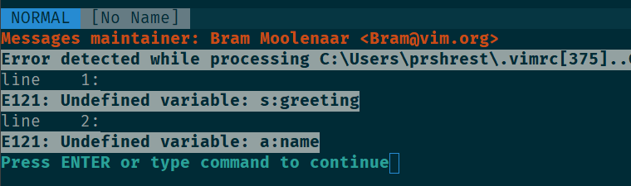
function: error handling
function g:Greet(message)
echom s:greeting
echom a:name
endfunction
call g:Greet("world")
Notes:
function g:Greet(message)
echom s:greeting
echom a:name
endfunction
call g:Greet("world")

Slide 19
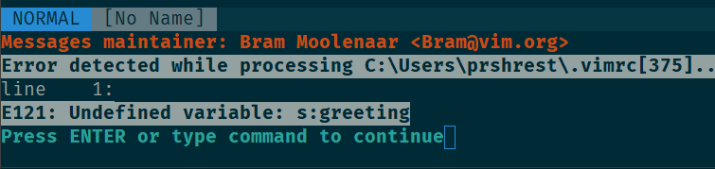
function: abort
function g:Greet(message) abort
echom s:greeting
echom a:name
endfunction
call g:Greet("world")
Notes:
function g:Greet(fullname) abort
echom s:greeting
echom a:name
endfunction
call g:Greet("world")

Slide 20
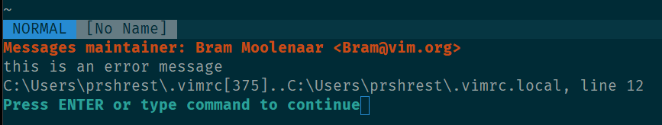
try..catch
try
throw 'this is an error message'
catch
echom v:exception
echom v:throwpoint
endtry
Notes:
try
throw 'this is an error message'
catch
echom v:exception
echom v:throwpoint
endtry

Slide 21
:h E128
try
function g:hello() abort
endfunction
call g:hello()
catch /E128/
echom 'caught E128:'
echom v:exception
echom v:throwpoint
catch /.*/
echom 'catch’
finally
echom 'finally’
endtry
Notes:
try
function g:hello() abort
endfunction
call g:hello()
catch /E128/
echom 'caught E128:'
echom v:exception
echom v:throwpoint
catch /.*/
echom 'catch'
finally
echom 'finally'
endtry

Slide 22
variable function arguments …
function! s:log(message, ...) abort
echom a:message
if a:0 > 0
echom a:1
endif
endfunction
call s:log("invalid error")
call s:log("invalid buffer", 1)
Notes:
function! s:log(message, ...) abort
echom a:message
if a:0 > 0
echom a:1
endif
endfunction
call s:log("invalid error")
call s:log("invalid buffer", 1)

Slide 23
if | … | endif
function! s:log(message, ...) abort
echom a:message
if a:0 > 2 | return | endif
if a:0 > 0 | echom a:1 | endif
if a:0 > 1 | echom a:2 | endif
endfunction
call s:log("invalid error")
call s:log("invalid buffer", 1)
Notes:
function! s:log(message, ...) abort
echom a:message
if a:0 > 2 | return | endif
if a:0 > 0 | echom a:1 | endif
if a:0 > 1 | echom a:2 | endif
endfunction
call s:log("invalid error")
call s:log("invalid buffer", 1)

Slide 24
a:000
function! s:log(message, ...) abort
echom a:message
for l:item in a:000
echom l:item
endfor
endfunction
call s:log("invalid error")
call s:log("invalid buffer", 1)
call s:log("invalid buffer", 1, 2, "three")
Notes:
function! s:log(message, ...) abort
echom a:message
for l:item in a:000
echom l:item
endfor
endfunction
call s:log("invalid error")
call s:log("invalid buffer", 1)
call s:log("invalid buffer", 1, 2, "three")

Slide 25
Strings

Slide 26
String Concatenation
let msg = 'Hello' . ' ' . 'world'
Notes:
let msg = 'Hello' . ' ' . 'world'

Slide 27
noignorecase
set noignorecase
function! s:log(word) abort
if a:word == 'one’
echom '1’
elseif a:word == 'two’
echom '2’
else
echom 'unknown’
endif
endfunction
call s:log('one’)
call s:log('One')
Notes:
set noignorecase
function! s:log(word) abort
if a:word == 'one'
echom '1'
elseif a:word == 'two'
echom '2'
else
echom 'unknown'
endif
endfunction
call s:log('one')
call s:log('One')

Slide 28
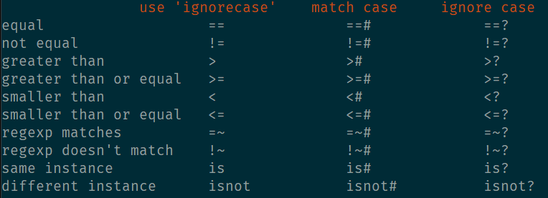
Comparison Operators

Slide 29
Single vs Double quotes
echo 'hello\nworld'
" prints
" hello\nworld
echo "hello\nworld"
" prints:
" hello
" world
Notes:
echo 'hello\nworld'
" prints
" hello\nworld
echo "hello\nworld"
" prints:
" hello
" world

Slide 30
string slice
let message = "helloworld"
echom message[0:4]
" hello
echom message[5:]
" world
echom message[-5:]
" world
echom message[:-6]
" hello
Notes:
let message = "helloworld"
echom message[0:4]
" hello
echom message[5:]
" world
echom message[-5:]
" world
echom message[:-6]
" hello

Slide 31
List & Dictionary

Slide 32
:h list
:h dict
Learn the apis:
  add
  remove
  has_key
  copy
  keys
  items()

Slide 33
Type Checking
echom type('hello') == v:t_string
echom type('world') == type('')
Notes:
echom type('hello') == v:t_string
echom type('world') == type('')

Slide 34
Callback
function! s:greet(name) abort
call timer_start(1000, function('s:timer_callback'))
endfunction
function! s:timer_callback(timer) abort
echom 'Hello name???'
endfunction
Notes:
function! s:greet(name) abort
call timer_start(1000, function('s:timer_callback'))
endfunction
function! s:timer_callback(timer) abort
echom 'Hello name???'
endfunction

Slide 35
Callback
function! s:greet(name) abort
call timer_start(1000, function('s:timer_callback', [a:name]))
endfunction
function! s:timer_callback(name, timer) abort
echom 'Hello ' . a:name
endfunction
Notes:
function! s:greet(name) abort
call timer_start(1000, function('s:timer_callback', [a:name]))
endfunction
function! s:timer_callback(name, timer) abort
echom 'Hello ' . a:name
endfunction

Slide 36
Lambda
function! s:greet(name) abort
call timer_start(1000, {t->s:timer_callback(name)})
endfunction
function! s:timer_callback(name) abort
echom 'Hello ' . a:name
endfunction
Notes:
function! s:greet(name) abort
call timer_start(1000, {t->s:timer_callback(name)})
endfunction
function! s:timer_callback(name) abort
echom 'Hello ' . a:name
endfunction

Slide 37
Events

Slide 38
:h autocmd
autocmd CursorMoved,CursorMovedI * call s:cursor_moved()
function! s:cursor_moved() abort
echom "cursor moved"
endfunction
Notes:
autocmd CursorMoved,CursorMovedI * call s:cursor_moved()
function! s:cursor_moved() abort
echom "cursor moved"
endfunction

Slide 39
:h autocmd-groups
augroup mygroup
autocmd CursorMoved,CursorMovedI * call s:cursor_moved()
augroup END
function! s:cursor_moved() abort
echom "cursor moved"
endfunction
Notes:
augroup mygroup
autocmd CursorMoved,CursorMovedI * call s:cursor_moved()
augroup END
function! s:cursor_moved() abort
echom "cursor moved"
endfunction

Slide 40
:h autocmd-groups
augroup mygroup
autocmd!
autocmd CursorMoved,CursorMovedI * call s:cursor_moved()
augroup END
function! s:cursor_moved() abort
echom "cursor moved"
endfunction
Notes:
augroup mygroup
autocmd CursorMoved,CursorMovedI * call s:cursor_moved()
augroup END
function! s:cursor_moved() abort
echom "cursor moved"
endfunction

Slide 41
:h write-plugin
Writing your first plugin

Slide 42
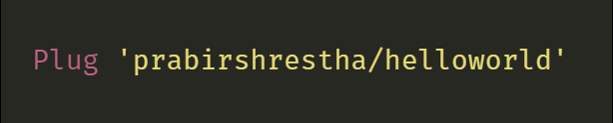
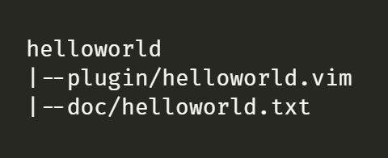
Hello World Plugin
Notes:
helloworld
|--plugin/helloworld.vim
|--doc/helloworld.txt

Slide 43
plugin/helloworld.vim
if exists('g:loaded_helloworld') | return | end
if let g:loaded_helloworld = 1
Notes:
if exists('g:loaded_helloworld') | return | endif
let g:loaded_helloworld = 1

Slide 44
Adding first command
if exists('g:loaded_helloworld') | finish | endif
let g:loaded_helloworld = 1
" user can call using :Greet command
command Greet call s:greet()
function! s:greet() abort
echom 'hello world’
endfunction
Notes:
if exists('g:loaded_helloworld') | finish | endif
let g:loaded_helloworld = 1
" user can now call using :Greet command
command Greet call s:greet()
function! s:greet() abort
echom 'hello world'
endfunction

Slide 45
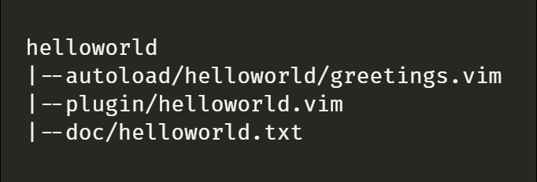
autoload
Notes:
helloworld
|--autoload/helloworld/greetings.vim
|--plugin/helloworld.vim
|--doc/helloworld.txt

Slide 46
autoload
" auoload/helloworld/greetings.vim
function helloworld#greetings#good_morning() abort
echom 'Good morning’
endfunction
" plugin/helloworld.vim
command Greet call helloworld#greetings#good_morning()
Notes:
" auoload/helloworld/greetings.vim
function helloworld#greetings#good_morning() abort
echom 'Good morning'
endfunction
" plugin/helloworld.vim
command Greet call helloworld#greetings#good_morning()

Slide 47
autoload – greetings.vim
function helloworld#greetings#good_morning() abort
echom 'Good morning’
endfunction
function! helloworld#greetings#good_afternoon() abort
call s:good_afternoon()
endfunction
function! s:good_afternoon()
echom 'Good afternoon’
endfunction
Notes:
function helloworld#greetings#good_morning() abort
echom 'Good morning'
endfunction
function! helloworld#greetings#good_afternoon() abort
call s:good_afternoon()
endfunction
function! s:good_afternoon()
echom 'Good afternoon'
endfunction

Slide 48
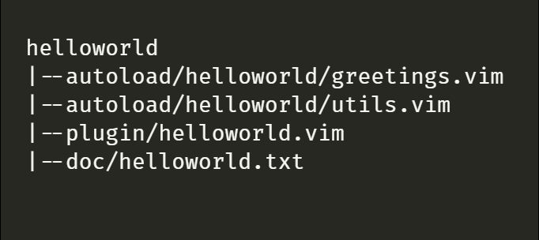
Organizing files
Notes:
helloworld
|--autoload/helloworld/greetings.vim
|--autoload/helloworld/utils.vim
|--plugin/helloworld.vim
|--doc/helloworld.txt

Slide 49
Organizing files
function! helloworld#greetings#greet() abort
let l:hour = helloworld#greetings#utils#get_hour()
if l:hour < 10
call helloworld#greetings#good_morning()
elseif l:hour < 17
call helloworld#greetings#good_afternoon()
else
echom 'Good evening’
endif
endfunction
Notes:
function! helloworld#greetings#greet() abort
let l:hour = helloworld#greetings#utils#get_hour()
if l:hour < 10
call helloworld#greetings#good_morning()
elseif l:hour < 17
call helloworld#greetings#good_afternoon()
else
echom 'Good evening'
endif
endfunction

Slide 50
Mappings
nnoremap <plug>(helloworld-greet) :<c-u>call helloworld#greetings#greet()<cr>
if !hasmapto('<Plug>(helloworld-greet)', 'n') && (mapcheck("<F9>", "n") == "")
nmap <silent> <F9> <plug>(helloworld-greet)
endif
Notes:
nnoremap <plug>(helloworld-greet) :<c-u>call helloworld#greetings#greet()<cr>
if !hasmapto('<Plug>(helloworld-greet)', 'n') && (mapcheck("<F9>", "n") == "")
nmap <silent> <F9> <plug>(helloworld-greet)
endif

Slide 51
Version & Feature check
if has('nvim')
echom 'in neovim'
else
echom in 'vim'
endif
if has('patch-8.1.889')
echom 'has patch 8.1.889'
endif
if !exists('timer')
echom 'vim compiled with timer required'
endif
if exists('##TextChangedP')
autocmd TextChangedP * call s:on_text_changed_p()
endif
Notes:
if has('nvim')
echom 'in neovim'
else
echom in 'vim'
endif
if has('patch-8.1.889')
echom 'has patch 8.1.889'
endif
if !exists('timer')
echom 'vim compiled with timer required'
endif
if exists('##TextChangedP')
autocmd TextChangedP * call s:on_text_changed_p()
endif

Slide 52
Best Practices
Set up CI
  Linting
  Tests
Document your plugin in vim doc format
Document your code, special attention to data structures used in code

Slide 53
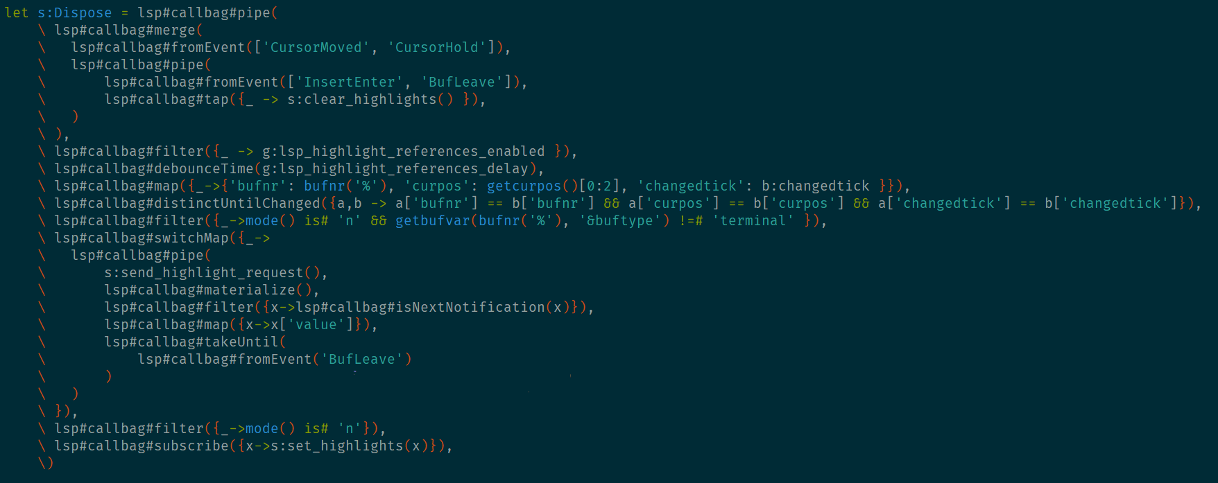
callbag.vim

Slide 54
Vimscript for the Javascripter
https://w0rp.com/blog/post/vim-script-for-the-javascripter/

Slide 55
What about Lua instead of Vimscript?

Slide 56
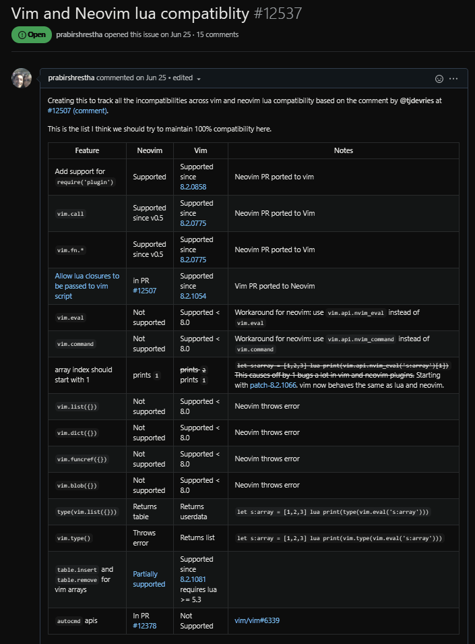

Vim & Neovim lua compatibility https://github.com/neovim/neovim/issues/12537

Slide 57
Thank You!!!
twitter.com/PrabirShrestha
github.com/PrabirShrestha

